Slide 1

ANALYSIS OF THE Reversal rate on appeal of Commercial court judgments imposing sanctions IN INSOLVENCY LAW (faillite personnelle and interdiction de gérer)
BY CHLOÉ GOLDSTEIN, CAROLINE PROT, ELVIRE JOLIMOY AND JULIEN LAPORTE

Slide 2

STEP 1: INTRODUCTION
SUMMARY
STEP 2: CREATION OF THE DATA FRAME
STEP 3: ANALYSIS OF THE DATA FRAME
STEP 4: CONCLUSION

Slide 3


STEP 1: INTRODUCTION

Slide 4

INTRODUCTION
I. DEFINITIONS OF PERSONAL BANKRUPTCY AND MANAGEMENT BAN: The sanction of personal bankruptcy may be pronounced by the court in charge of the collective proceedings when the manager has committed a fault in the management of his company, thus participating in the opening of a judicial recovery or liquidation procedure.
Personal bankruptcy (faillite personnelle): « Personal bankruptcy entails a ban on directing, managing, administering or controlling, directly or indirectly, any commercial or craft enterprise, any farm or any enterprise with any other independent activity and any legal person » (Article L.653-2 of the French Commercial Code)
Management ban (interdiction de gérer): ban on directing, managing, administering or controlling, directly or indirectly, a company or any legal person (Article L.653-8 of the French Commercial Code)
II. PURPOSE OF THE PROJECT: analyze the number of decisions sentencing to such sanctions, the rate of confirmation in appeal and comparing the severity of the different Courts.

Slide 5
STEP 2: CREATION OF THE DATA FRAME

Slide 6

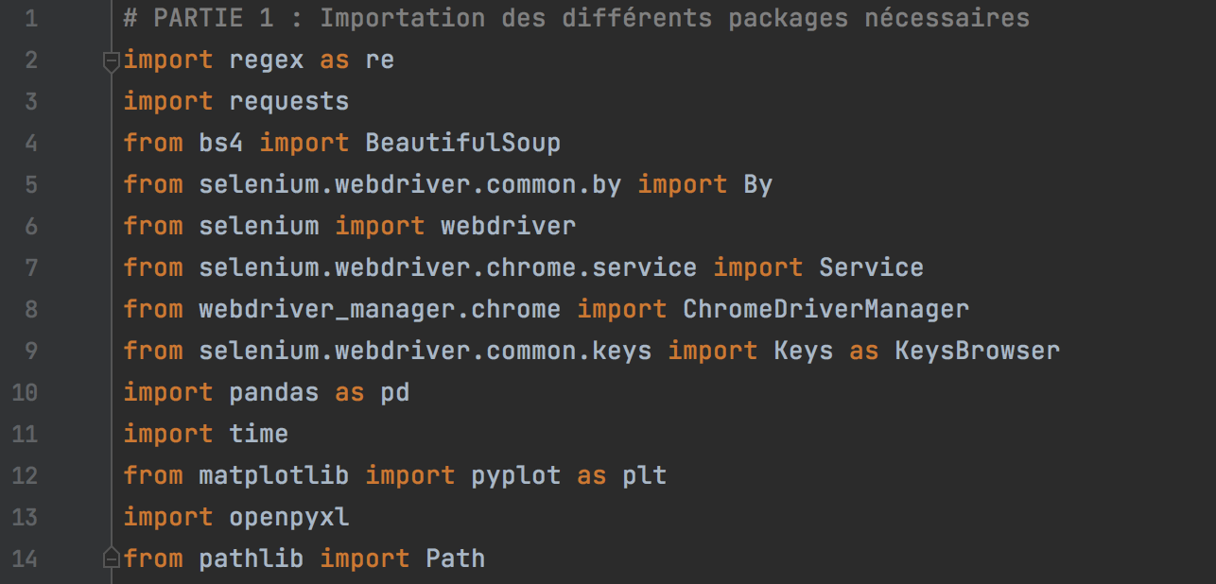
PART 1: IMPORTATION OF THE PACKAGES NECESSARY

Slide 7
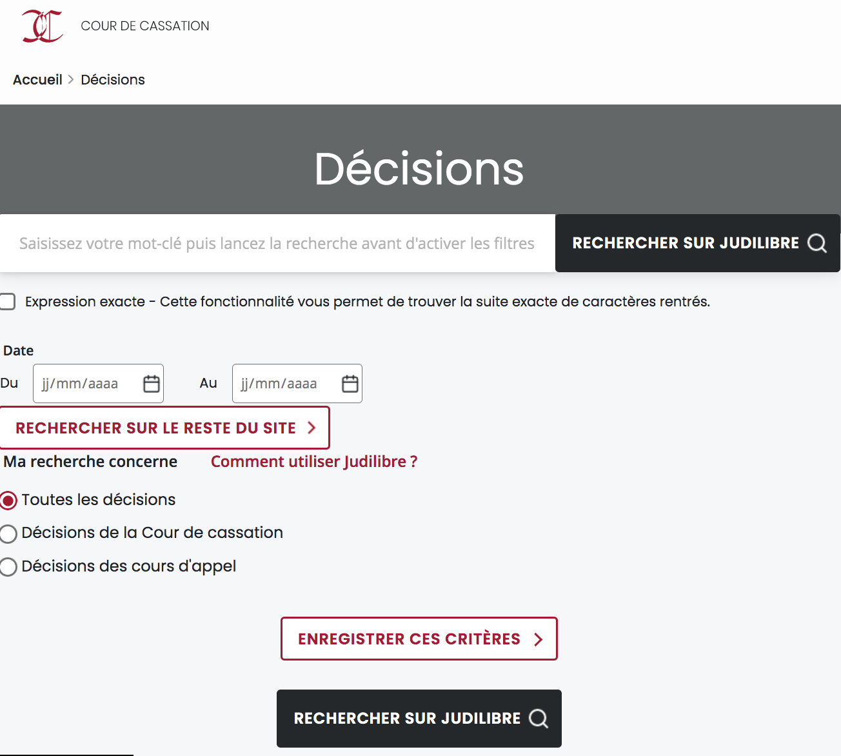
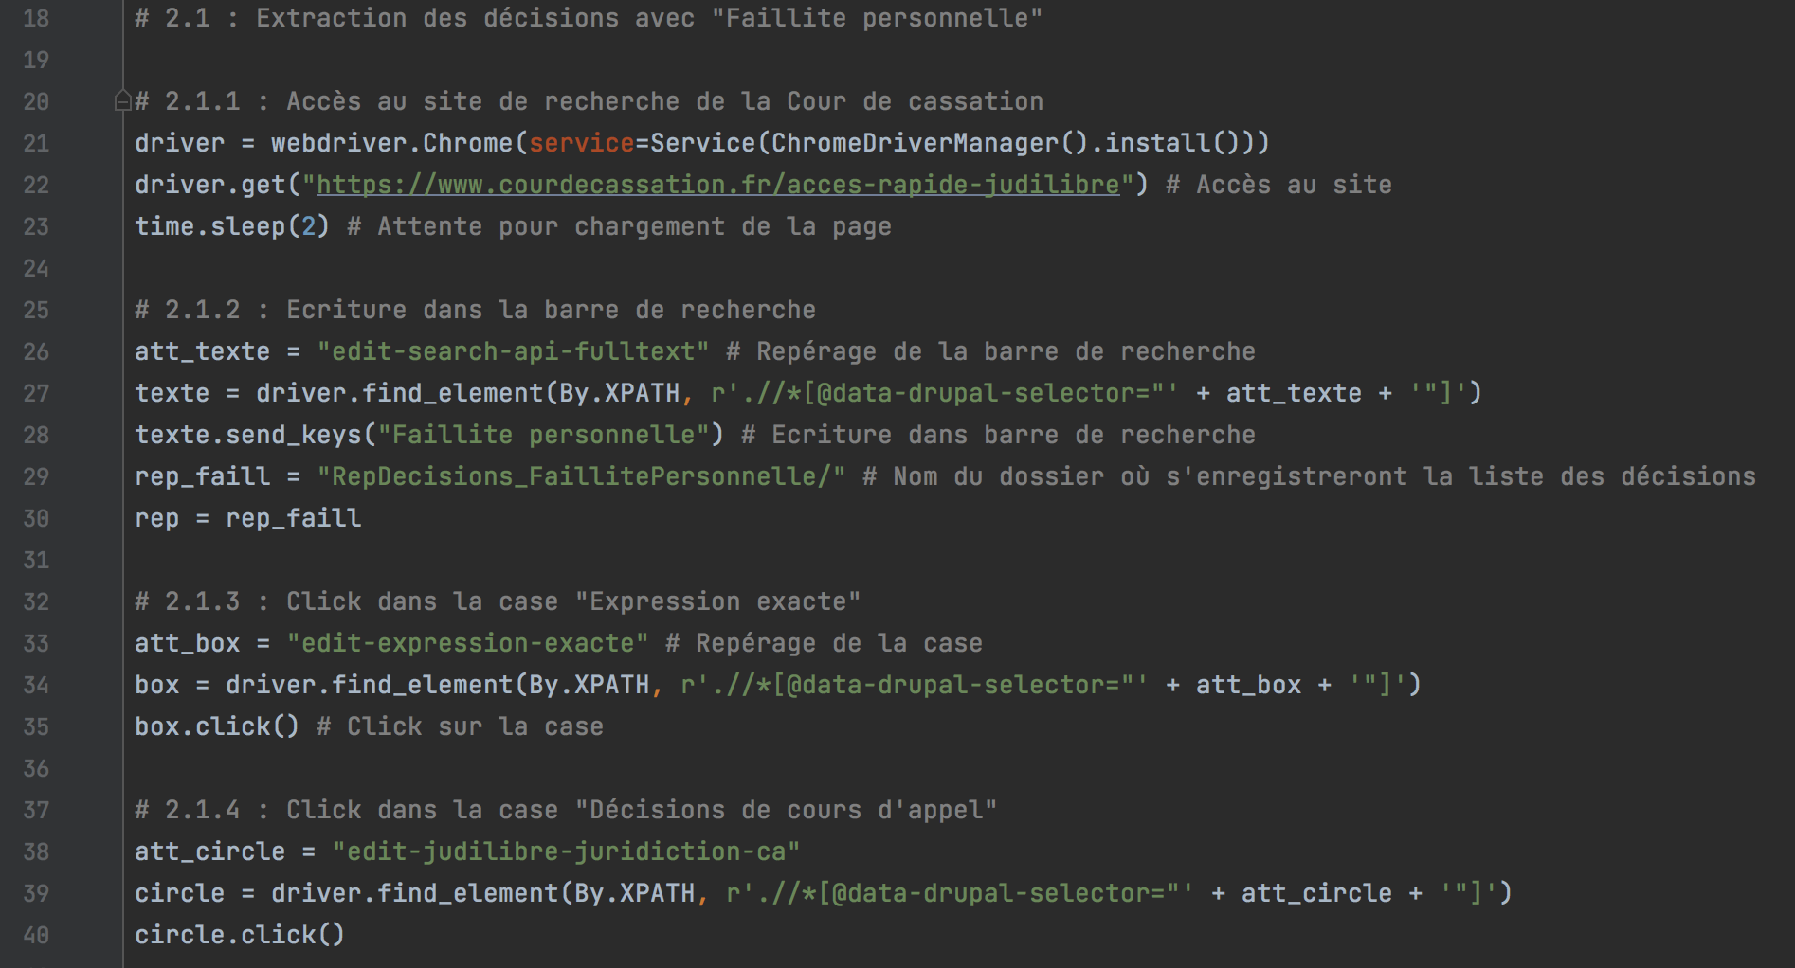
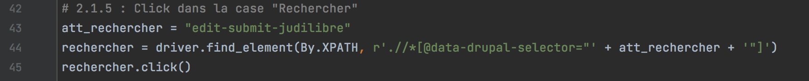
PART 2.1: SCRAPING OF DECISIONS WITH « FAILLITE PERSONNELLE »
SUBPART 1 to 5: Looking for decisions on the
Cour de cassation website
1
1
2
2
3
3
4
4
5
5

Slide 8
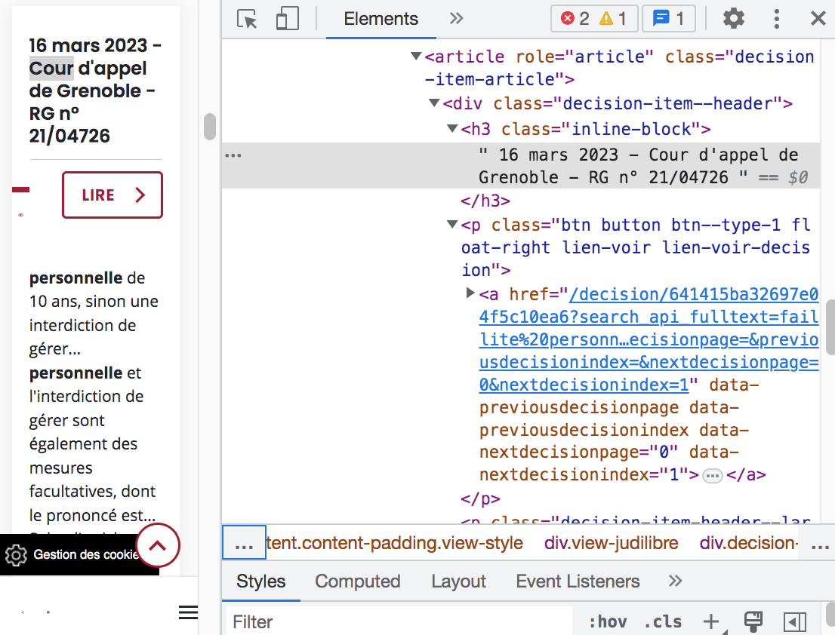
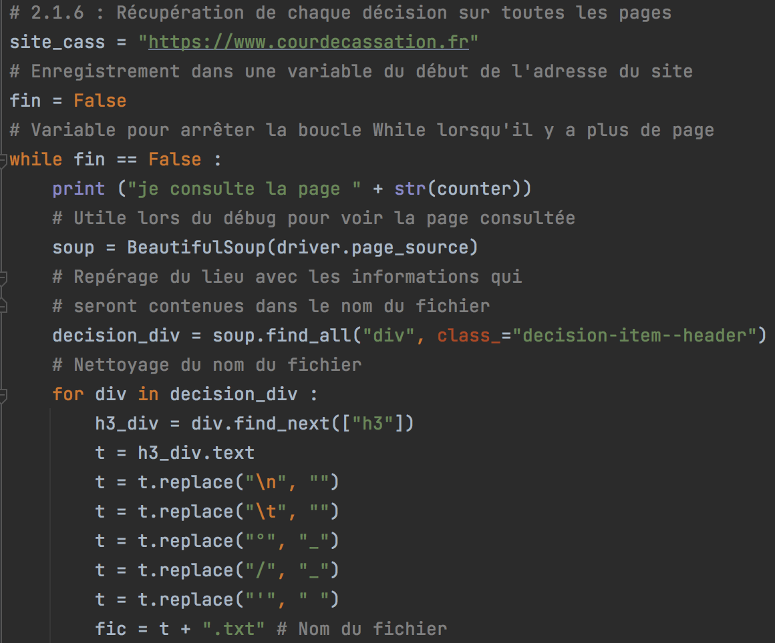
PART 2.1: SCRAPING OF DECISIONS WITH « FAILLITE PERSONNELLE »
SUBPART 6.1: File name cleanup

Slide 9
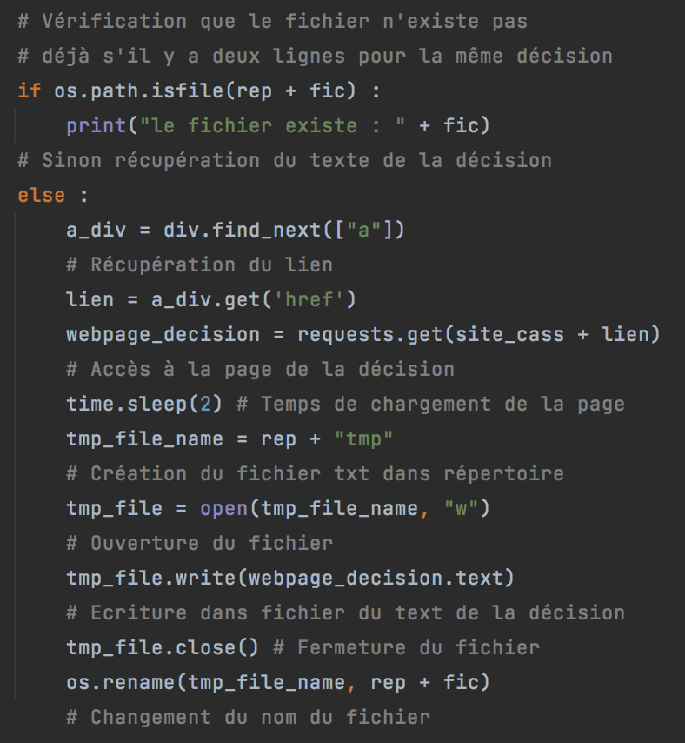
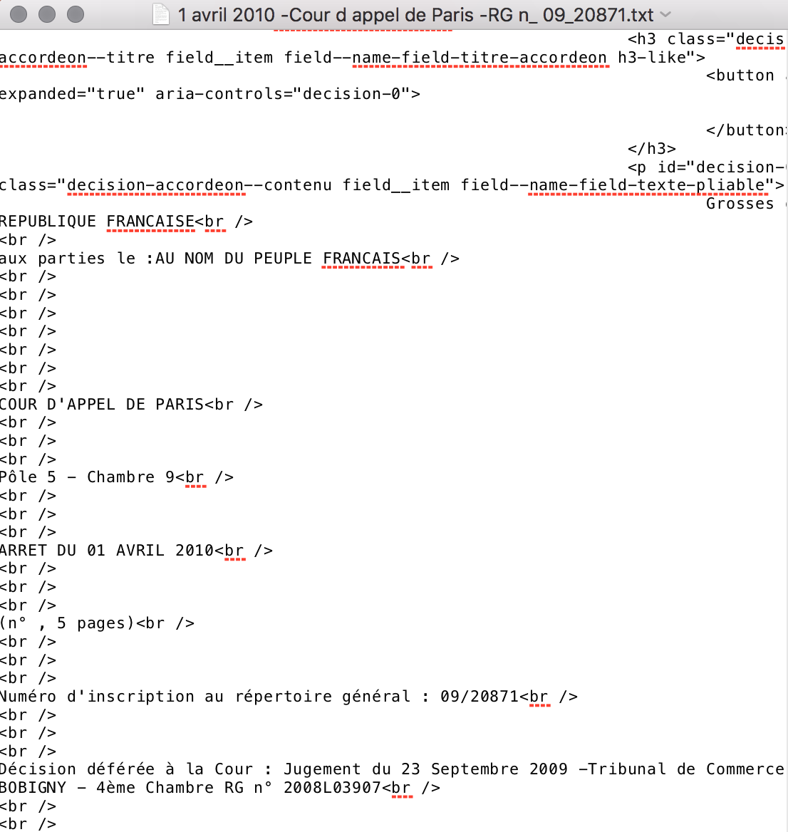
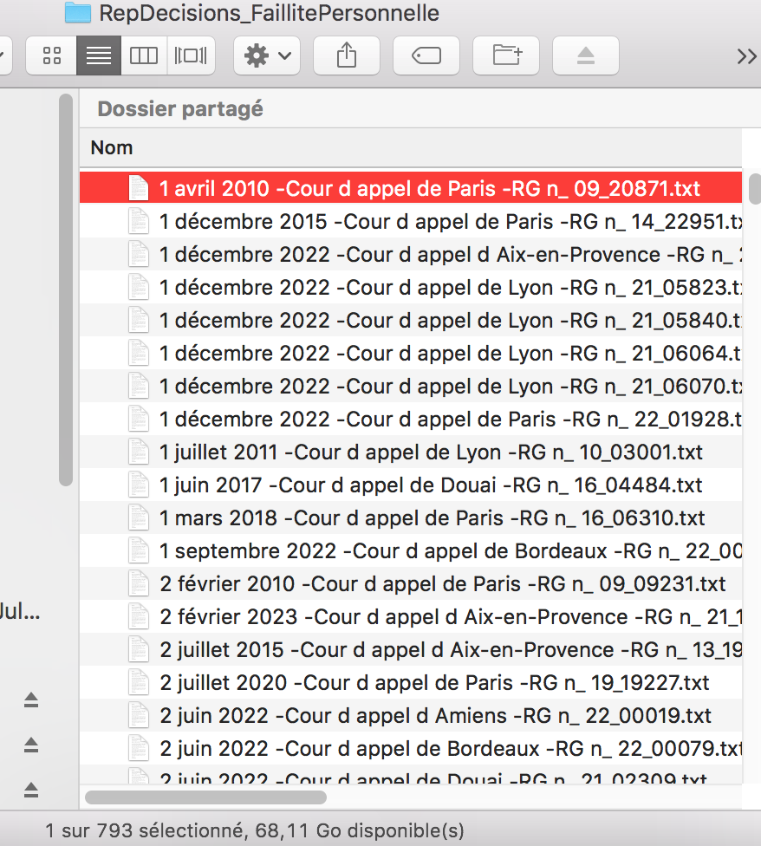
PART 2.1: SCRAPING OF DECISIONS WITH « FAILLITE PERSONNELLE »
SUBPART 6.2: Creation and name writing for every file

Slide 10
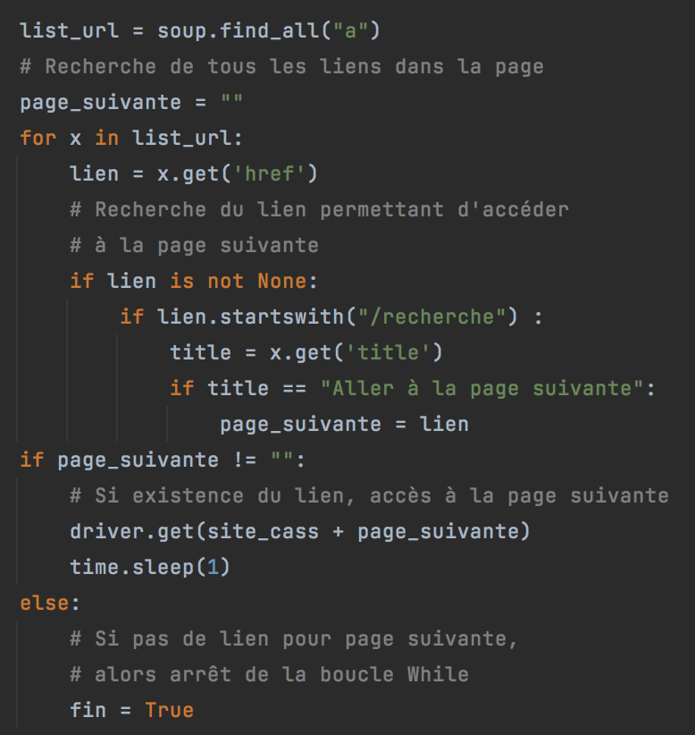
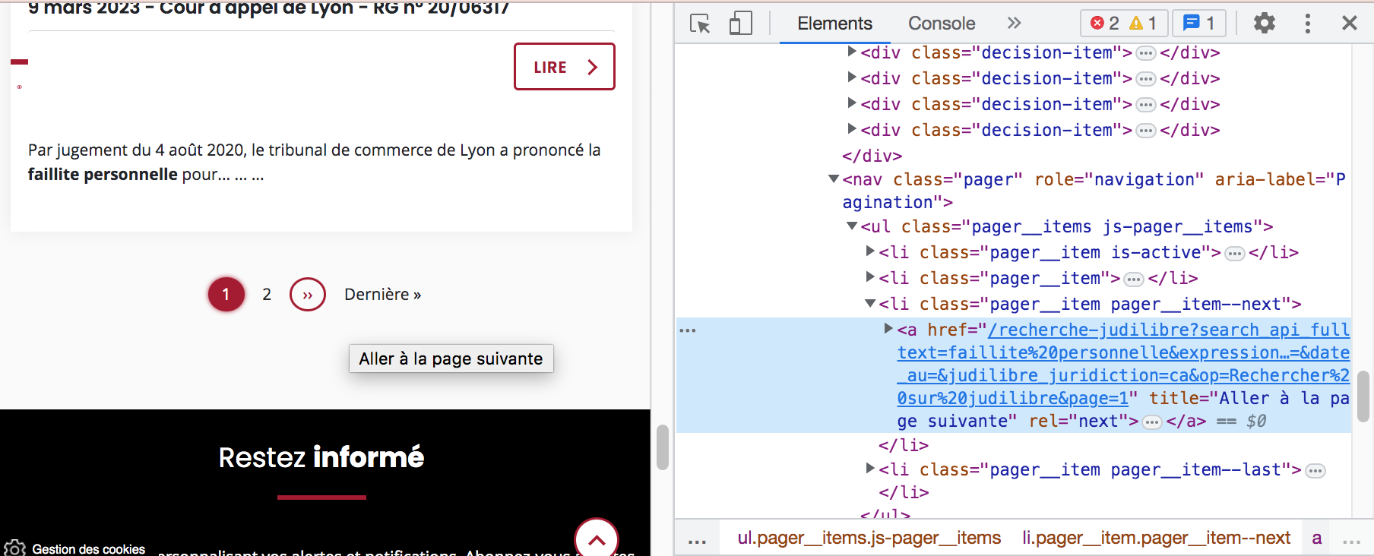
PART 2.1: SCRAPING OF DECISIONS WITH « FAILLITE PERSONNELLE »
SUBPART 6.3: Finding the link and going to the next page

Slide 11
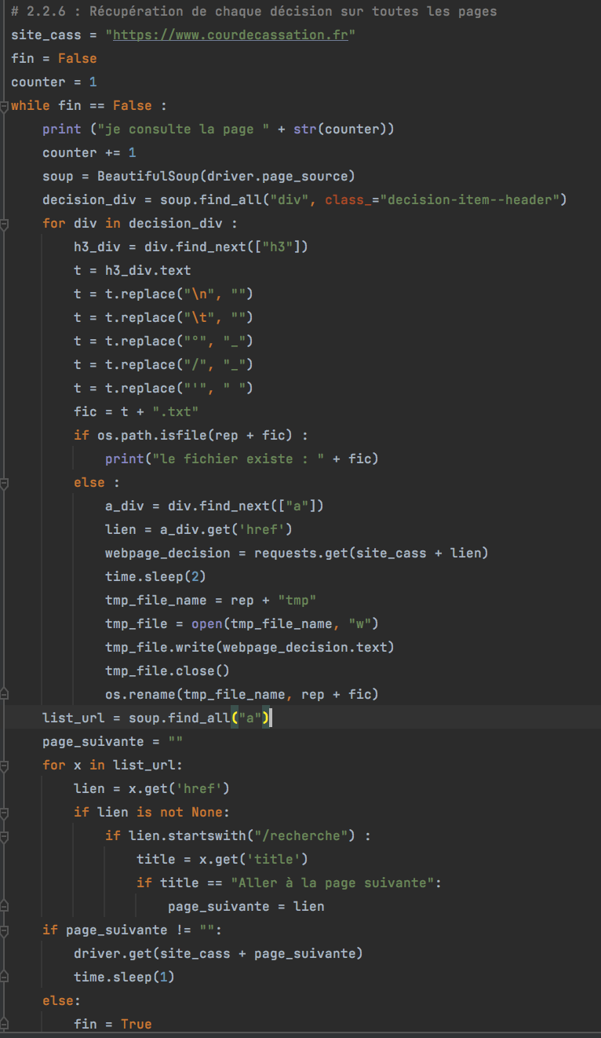
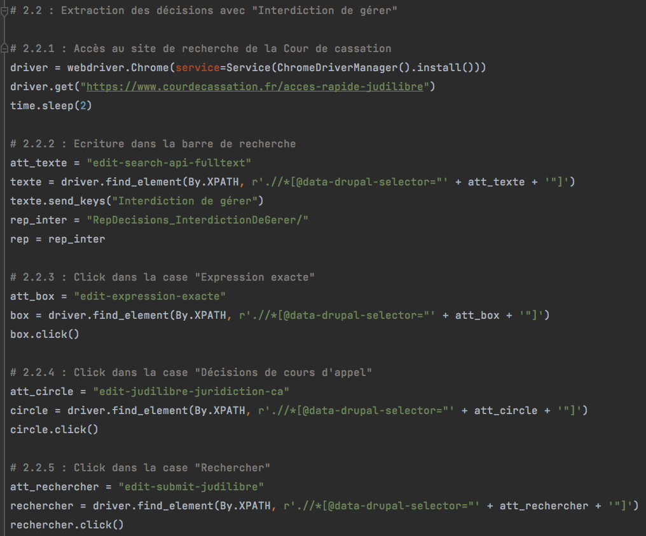
PART 2.2: SCRAPING OF DECISIONS WITH « INTERDICTION DE GÉRER »

Slide 12
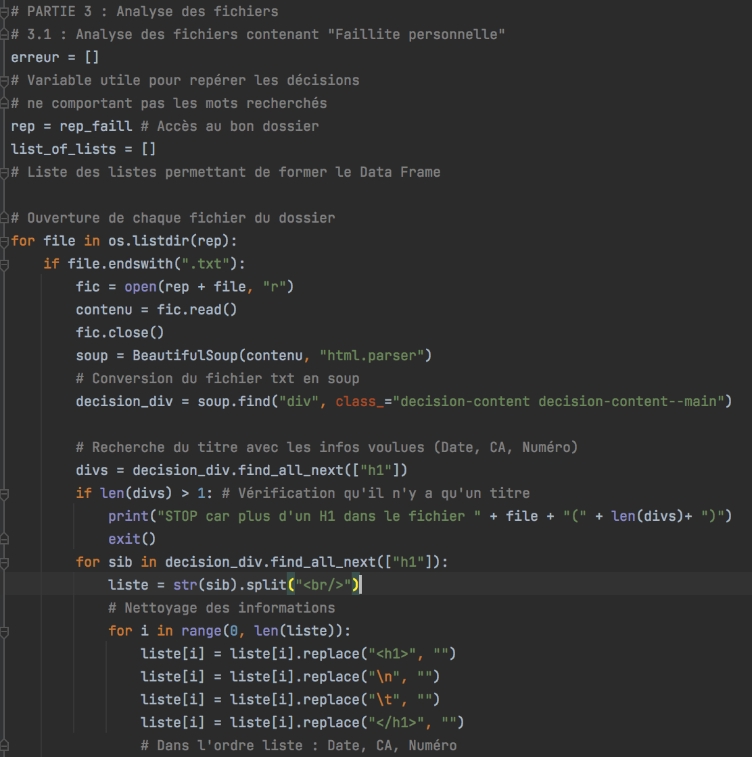
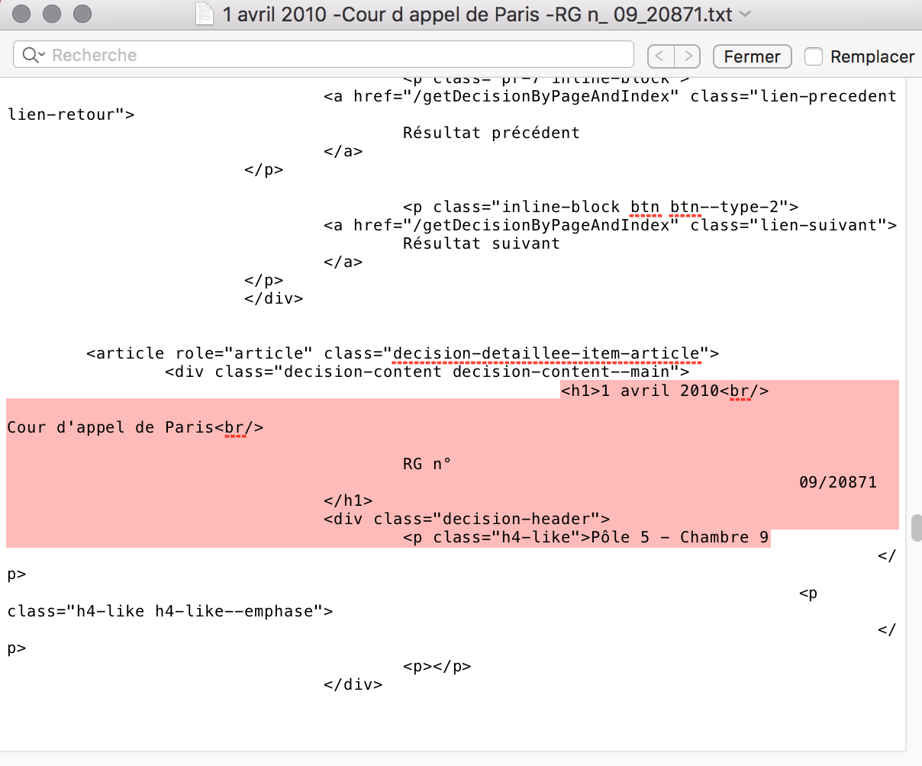
PART 3.1: ANALYSIS OF FILES WITH « FAILLITE PERSONNELLE »
SUBPART 1: Finding data : Date, CA and Numero of decisions

Slide 13
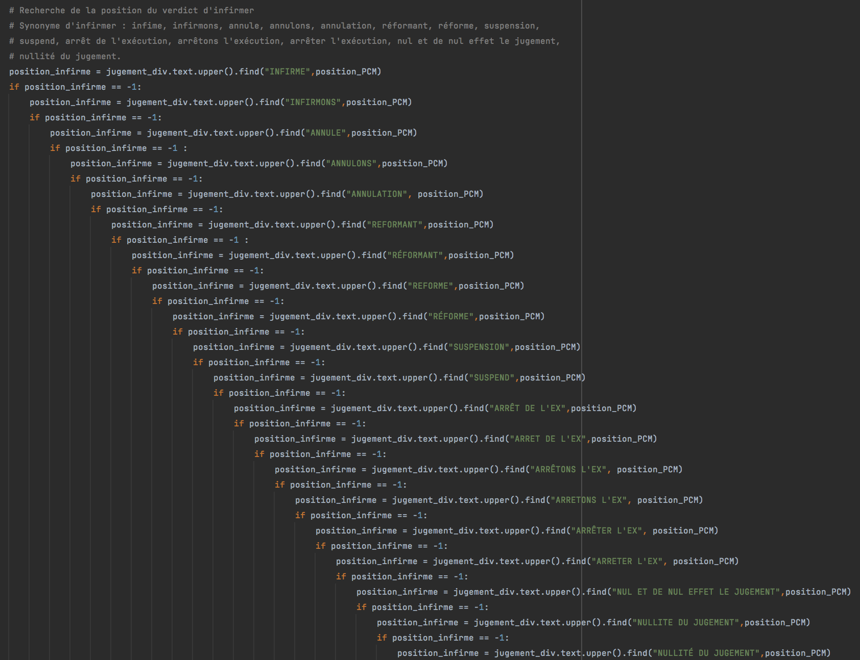
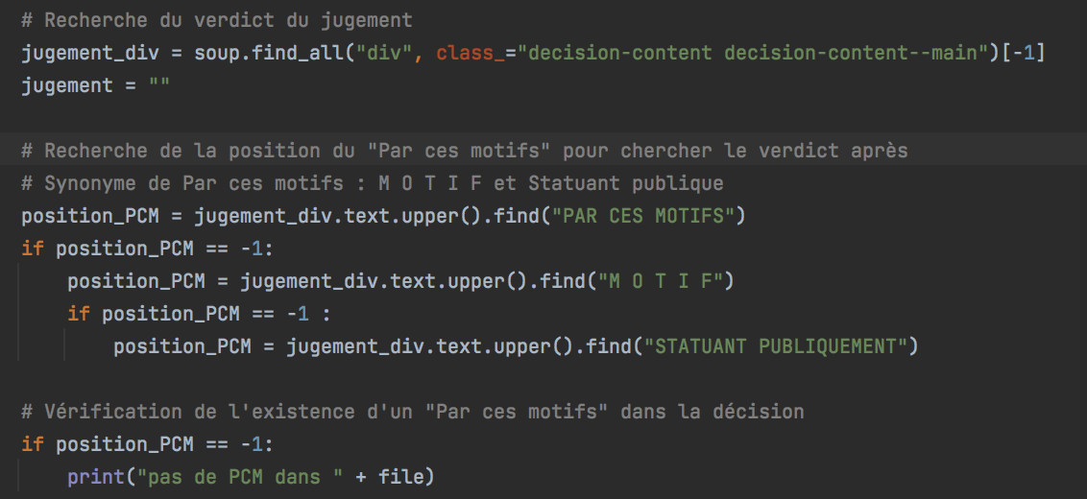
PART 3.1: ANALYSIS OF FILES WITH « FAILLITE PERSONNELLE »
SUBPART 2: Finding the ruling part
Step 2. Finding if the decision is invalidated?
Synonyms: infirme, infirmons, annule, annulons, annulation, réformant, réforme, suspension, suspend, arrêt de l’exécution, arrêter l’exécution, nul et de nul effet, nullité
Step 1. Finding « Par ces motifs »

Slide 14
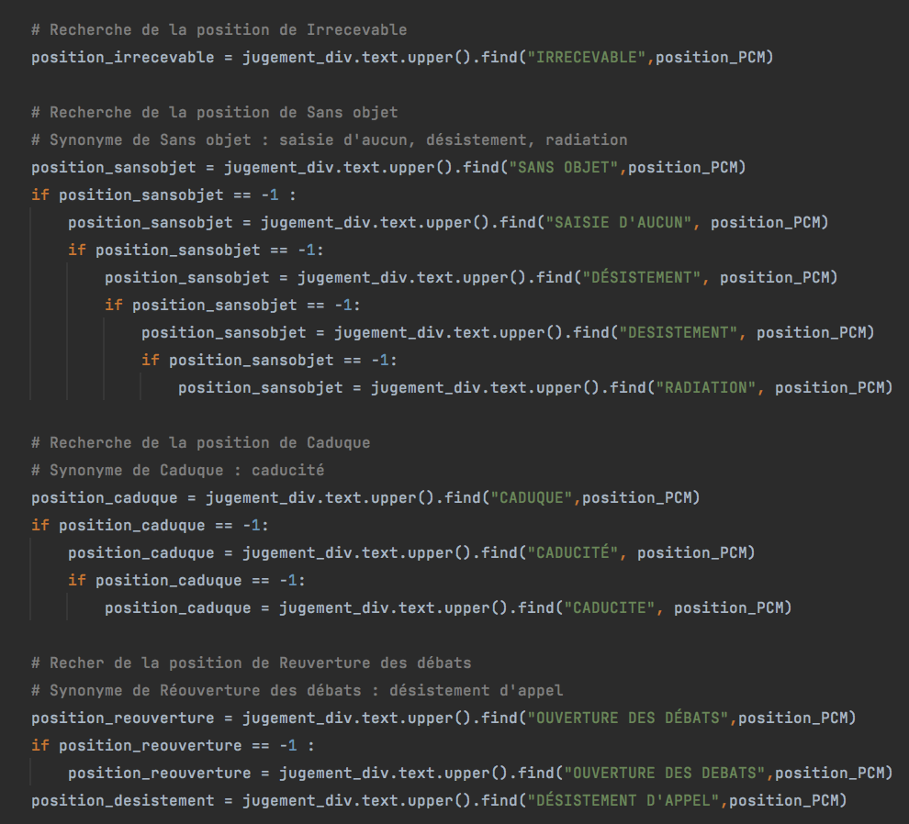
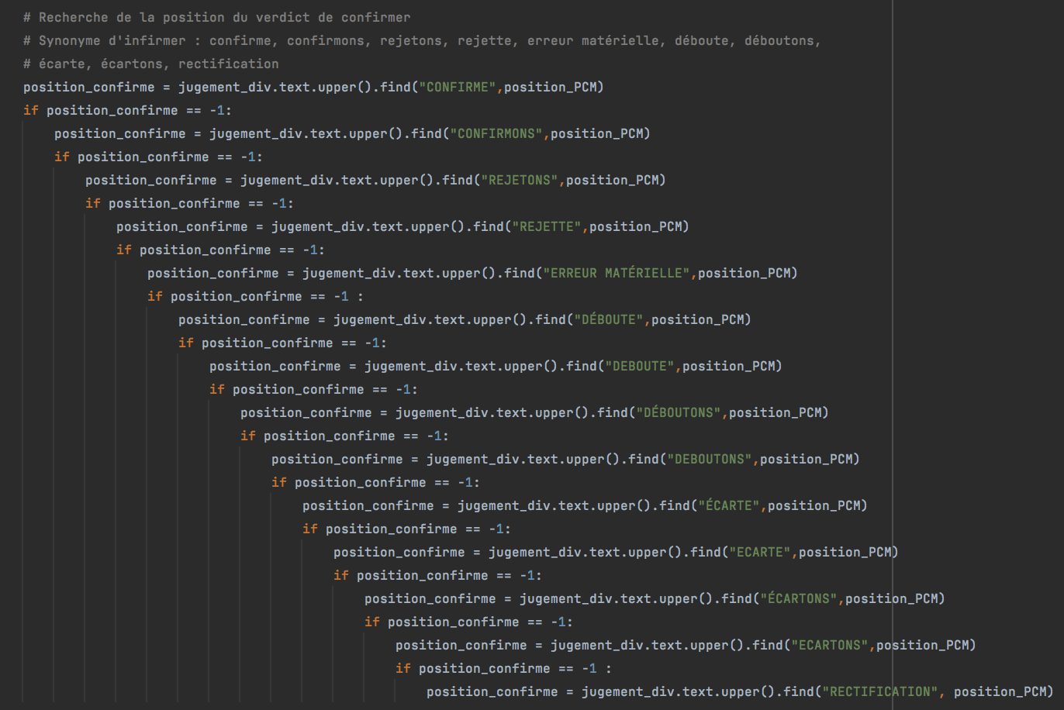
PART 3.1: ANALYSIS OF FILES WITH « FAILLITE PERSONNELLE »
SUBPART 2: Finding the ruling
Step 4. Finding if the decision is inadmissible, irrelevant, null and void or reopening of debats?
Step 3. Finding if the decision is validated?
Synonyms: confirme, confirmons, rejetons, rejette, erreur matérielle, déboute, déboutons, écarte, écartons, rectification

Slide 15
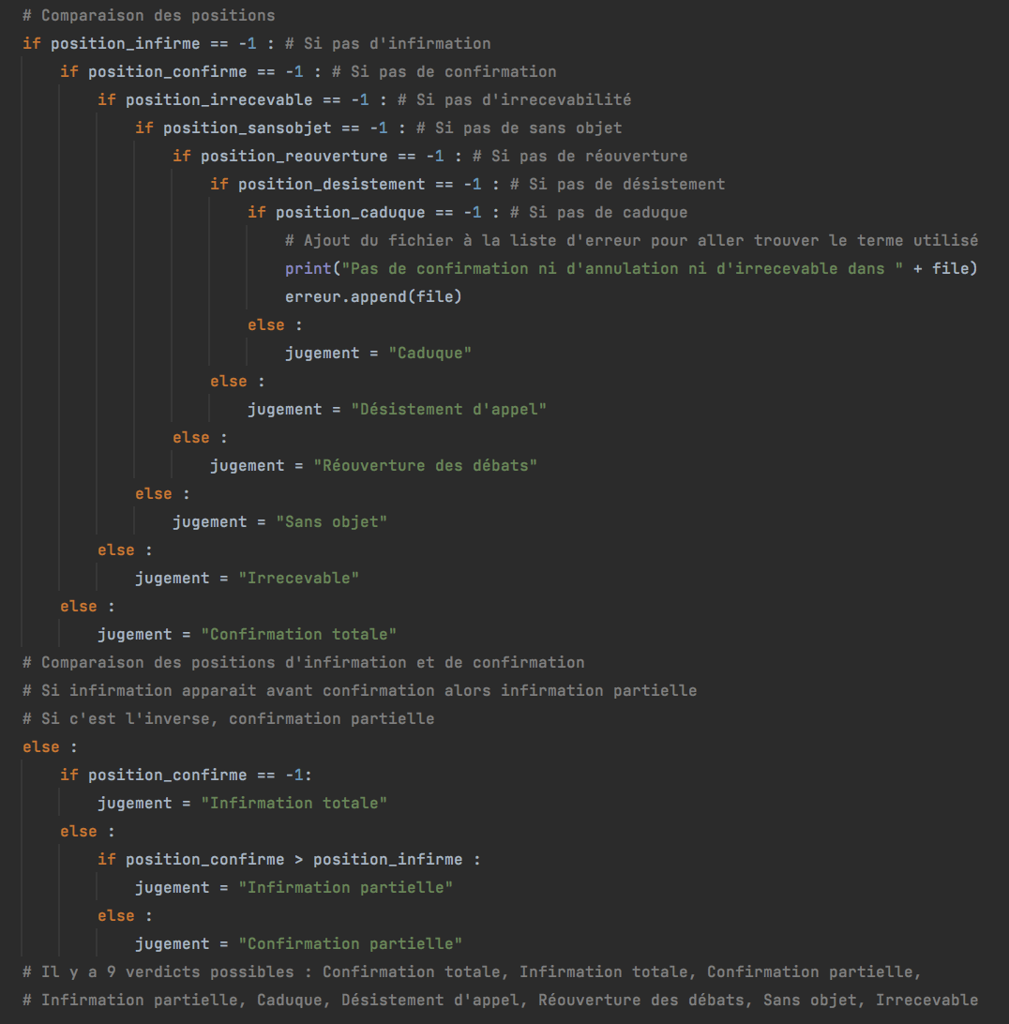
PART 3.1: ANALYSIS OF FILES WITH « FAILLITE PERSONNELLE »
SUBPART 2: Finding the ruling
Step 5. Comparing positions of the terms

Slide 16
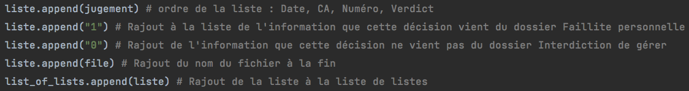
PART 3.1: ANALYSIS OF FILES WITH « FAILLITE PERSONNELLE »
SUBPART 3: Incrementing the list of lists

Slide 17
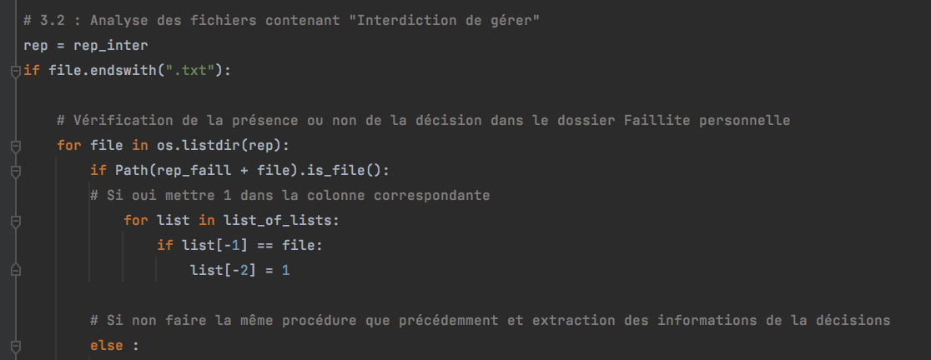
PART 3.2: ANALYSIS OF FILES WITH « INTERDICTION DE GERER »
Before doing the same:
Check if the decision is already present in the other folder

Slide 18
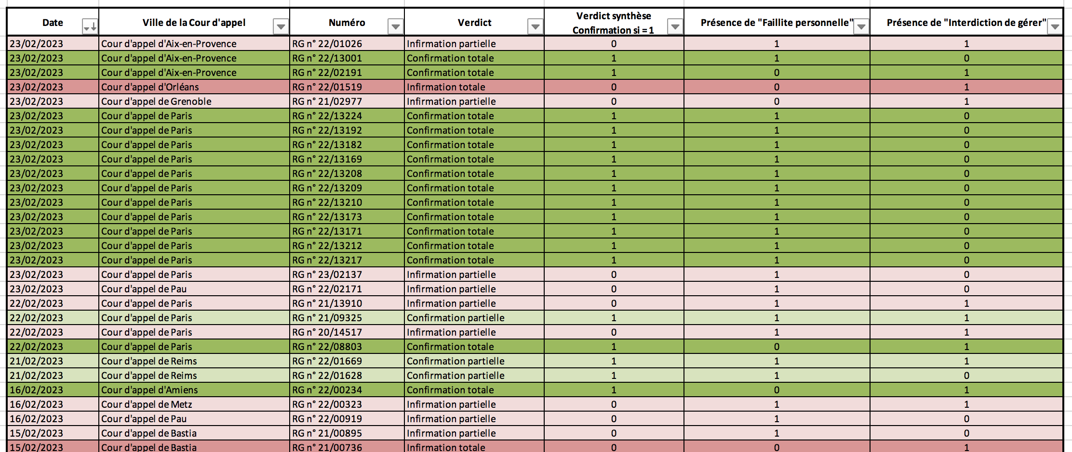
PART 4: EXPORTATION OF DATA IN EXCEL

Slide 19
STEP 3: ANALYSIS OF THE DATA FRAME

Slide 20
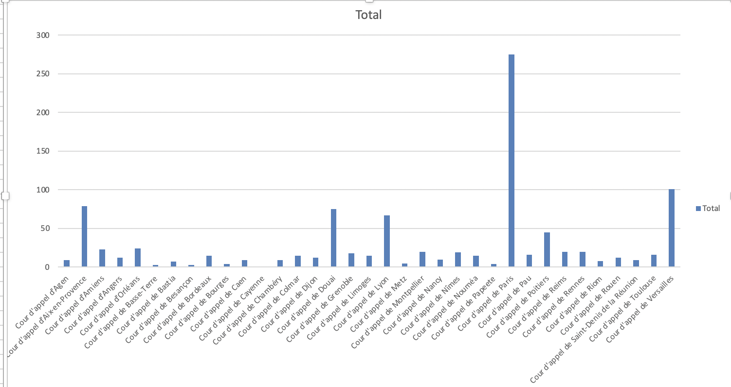
NUMBER OF DECISIONS IMPOSING SANCTIONS IN INSOLVENCY LAW (FROM 1998 TO 2023)
KEY POINTS
Few examples:
Paris: 275
Versailles: 101
Cayenne: 1
Papeete: 4
Total number of decisions: 995
Courts of Appeal that impose the highest number of sanctions:
Paris
Versailles
Aix-en-Provence
Douai
Lyon
Some Courts of appeal issue many decisions whereas others issue very few decisions
Representative of the economic distribution of wealth in France and the economic dynamism of a geographical area

Slide 21
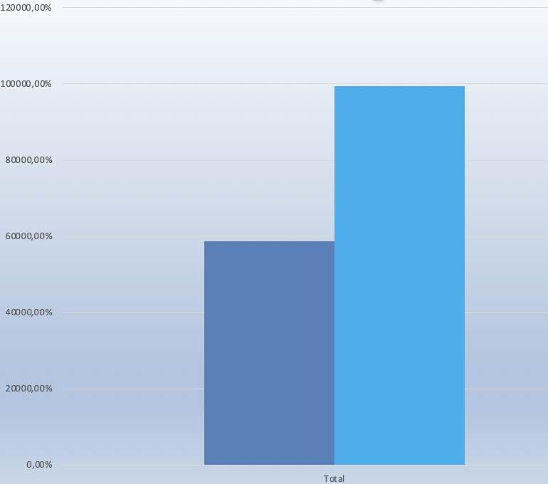
RATE OF SUCCESS (ALL COURTS OF APPEAL AND ALL YEARS)
KEY POINTS
Percentage of first instance decisions imposing sanctions upheld on appeal: 58,7%
Percentage of first instance decisions overturned on appeal: 41,3%
Conclusion: a first instance decision imposing insolvency law sanction is more likely to be upheld on appeal

Slide 22
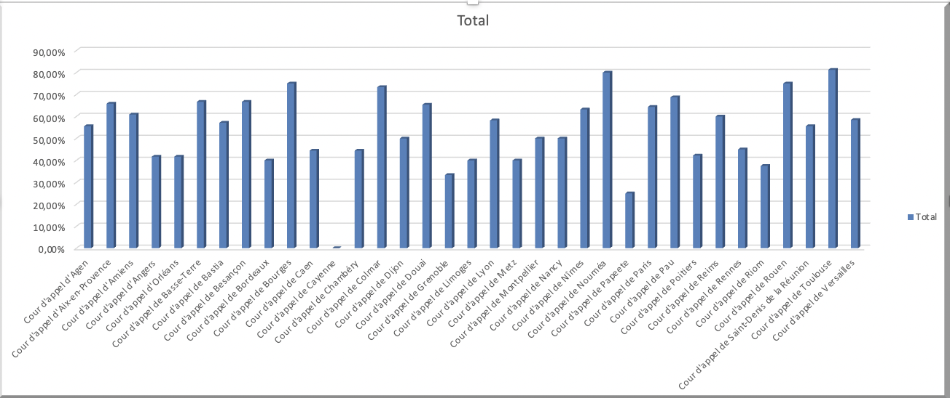
RATE OF CONFIRMATION BY COURT OF APPEAL (FROM 1998 TO 2023)
KEY POINTS
Lack of homogeneity between decisions issued by the Courts of Appeal
Some Courts of Appeal almost systematically (>70%) confirm first instance decisions: Bourges Court of Appeal, Nouméa Court of Appeal, Toulouse Court of Appeal
Some Courts of Appeal overturn most of the time (>50%) first instance decisions: Angers Court of Appeal, Orléans Court of Appeal, Bordeaux Court of Appeal, Grenoble Court of Appeal
Aim of this analysis : Is it useful to form an appeal of the first instance’s decision ?

Slide 23
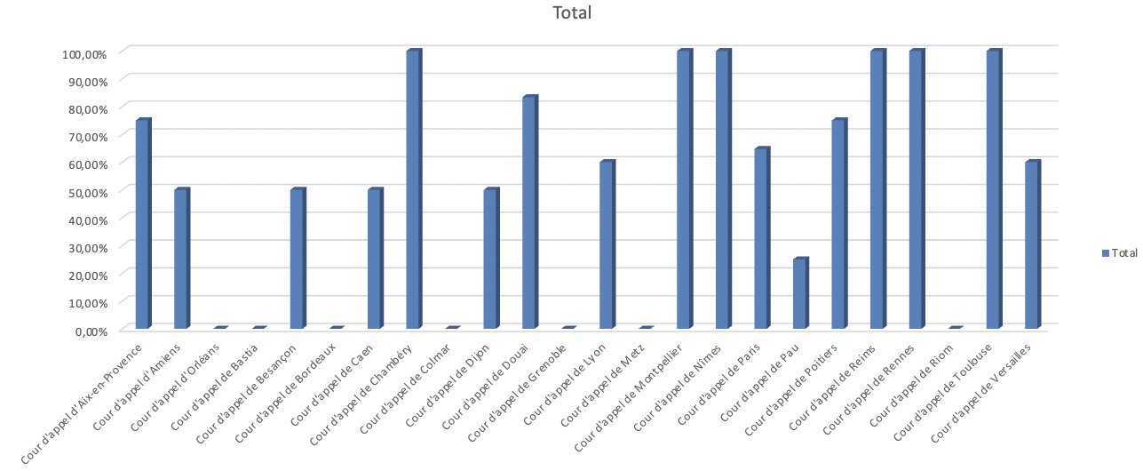
RATE OF CONFIRMATIONS BY COURT OF APPEAL (2023 ONLY)
KEY POINTS
Most Courts of Appeal confirmed first instance decisions – with several Courts of Appeal confirming almost 100% of the time first instance decisions (Toulouse Court of Appeal, Montpellier Court of Appeal, Reims Court of Appeal)
Except for several Courts of Appeal (Pau Court of Appeal, Dijon Court of Appeal, Amiens Court of Appeal)

Slide 24
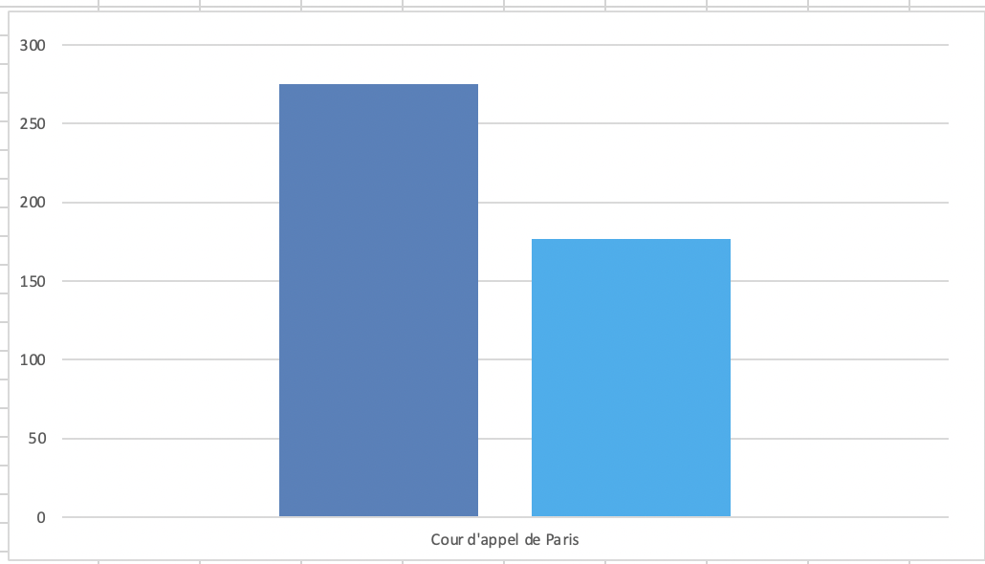
FOCUS ON PARIS COURT OF APPEAL
KEY POINTS
Total number of decisions: 275
28.8% of total decisions
Number of decisions confirmed on appeal: 177
Percentage of first instance decisions imposing insolvency law sanctions confirmed on appeal: 64,3%
Average of first instance decisions imposing insolvency law sanctions confirmed on appeal by Paris Court of Appeal > Average of all Courts of Appeal
64,3% > 58,7%
Total number of decisions
Number of decisions confirmed on appel

Slide 25
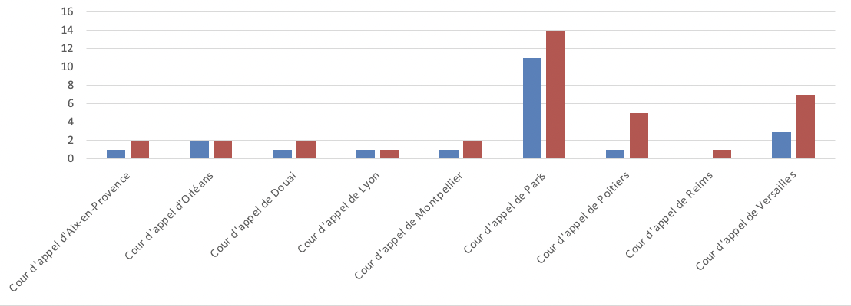
NUMBER OF DECISIONS IN 2020
KEY POINTS
Total number of decisions: 36
Number of decision confirming: 21
Percentage of first instance decisions imposing insolvency law sanctions confirmed on appeal: 58,3%

Slide 26
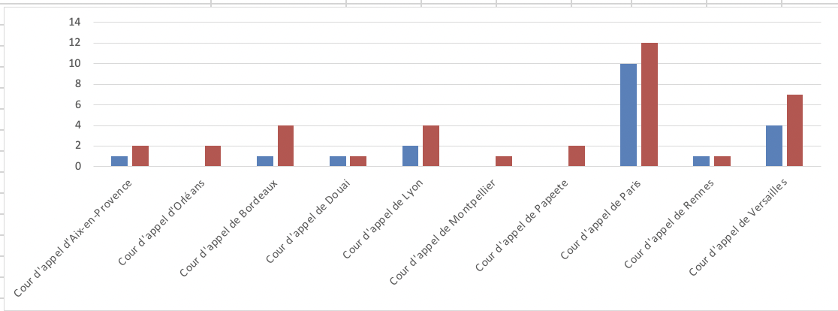
NUMBER OF DECISIONS IN 2021
KEY POINTS
Total number of decisions: 36
Number of decision confirming: 20
Percentage of first instance decisions imposing insolvency law sanctions confirmed on appeal: 55,5 %

Slide 27
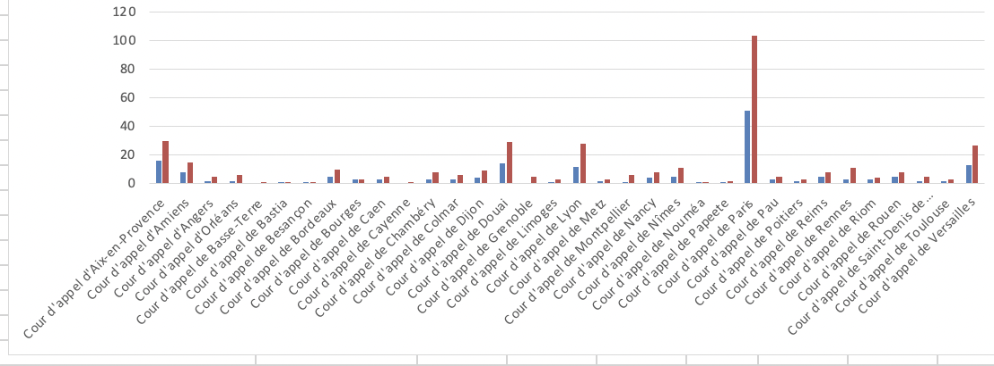
NUMBER OF DECISIONS IN 2022
KEY POINTS
Total number of decisions: 375
Number of decision confirming: 181
Percentage of first instance decisions imposing insolvency law sanctions confirmed on appeal: 48,2%

Slide 28
STEP 4: CONCLUSION

Slide 29
CONCLUSION
This analysis allows us to see where the most decisions are ruled.
The French economy is focused in big cities like Paris or in the Parisian area (Versailles).
Some Courts of appeal overrule the decision of the first instance Court more easily.
Useful information to know when a client is convicted.
Did Covid-19 had an impact on the number of decisions ?

